Slide 1
Stack And Queue By using Arrays
Presented by
Pavan kumar

Slide 2
Contents
Introduction
what is stack and queue
Stack operations
Queue operations
Differences
Advantages and disadvantages
Applications
References

Slide 3
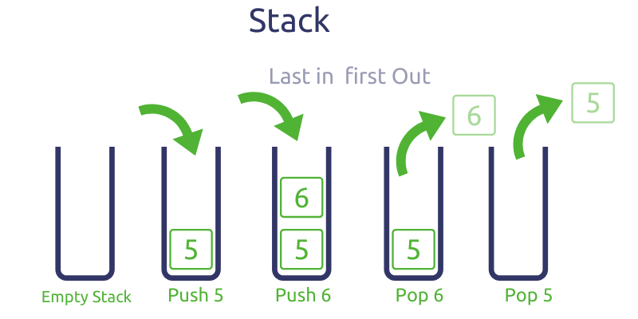
Stack
Stack is constructed based on last in first out mechanism.
Consider an example of plates stacked over one another in the canteen.
By using stack we can implement process handling, file handling and function handling.

Slide 4
Stack operations
Push(add at beginning):inserting an element at top
Pop(delete at beginning):deleting an element at top
Display: to display all elements.
Search: to search particular element is present or not.
Now, in the operations assume i=-1 initialized globally.
SIZE is macro of array size (#define SIZE <required size>)

Slide 5
Pop operation
Push operation
void main()
{
printf(“enter a number”);
scanf(“%d”,&num);
push(stack,num);
pop();
}
void push(int *ptr,int num)
{
if(i==SIZE-1)//stack is full
{
printf(“stack is full\n”);
return;
}
i++; //stack is not full
ptr[i]=num;
}
void pop()
{
if(i==-1)//stack is empty
{
printf(“stack is empty\n”);
return;
}
i--;//stack is empty
}
10 | 20 | 30 | 40 | 50
10 | 20 | 30 | 40 | 50

Slide 6
DISPLAY OPERATION
SEARCH OPERATION
int search(int *ptr,int num)
{
int j;
if(i==-1)
{
printf(“stack is empty\n”);//stack is empty
return;
}
for(j=0;j<=I;j++)//stack contain nodes
{
If(ptr[j]==num)
return j+1;
}
return -1
}
void display(int *ptr)
{ int j;
if(i==-1)
{
printf(“stack is empty\n”);//stack is empty
return;
}
for(j=0;j<=I;j++) //stack contain nodes
{
printf(“%d\n”,ptr[j]);
}
}
10 | 20 | 30 | 40 | 50
10 | 20 | 30 | 40 | 50

Slide 7
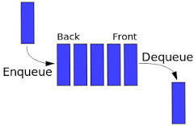
Queue
Queue is constructed based on first in first out mechanism.
An excellent example of a queue is a line of students in the food court.
Through queue we can implement running queue, waiting queue and priority queue

Slide 8
Queue operations
Insert(add at last): it is about add an element in queue at last which is known as Enqueue
Delete(delete at begin):it is about deleting an element from front as Dequeue
Display: to display the elements in nodes in the queue
Search: to search an element is present or not.
Now in operations ,assume front and rear as f and r initialize with -1 globally.
Queue size is given as macro (#define SIZE <required size>.

Slide 9
Insert
Delete
void insert (int *ptr, int num)
{
if(f==-1)
f++,r++;
else if(((r==SIZE-1)&&(f==0))||(r==f-1))//queue is full
{
printf(“queue is full\n”);
return;
}
else if(r==SIZE-1)//to insert elements at front vacant places
{
r=0;
ptr[r]=num;
return;
}
else //to insert elements
r++;
ptr[r]=num;
}
void delete ( )
{
If(f==-1)
{
printf(“queue is empty\n”);//queue is empty
return;
}
else if(f==r)
{
f=r=-1;//queue contains single element
return;
}
else if(f==SIZE-1)//elements remain at starting positions
{
f=0;
return;
} //to delete elements
f++;
}
10 | 20 | 30 | 40 | 50
10 | 20 | 30 | 40 | 50

Slide 10
Display
Search
Void display(int *ptr)
{
int I;
If(f==-1)//queue is empty
{
printf(“queue is empty”);
return;
}
If(f<=r)//to print f to r index elements
{
for(i=f;i<=r;i++)
printf(“%d\n”,ptr[i]);
}
else if(r<f)//to print f to last index elements and print 0 to r index
{
for(i=f;i<=SIZE-1;i++)
Printf(“%d\n”,ptr[i]);
for(i=0;i<=r;i++)
Printf(“%d\n”,ptr[i]);
}
}
Void search(int *ptr, int num)
{ int I,i=1;
If(f==-1)//queue is empty
{ Printf(“queue is empty”);
return;
}
If(f<=r)
{ for(i=f;i<=r;i++)//queue contain elements
{ if(ptr[i]==num)
return i+1;
}
}
else if(r<f)
{ for(i=f;i<=SIZE-1;i++)
{ if(ptr[i]==num)
return j;
j++;}
for(i=0;i<=r;i++) {
if(ptr[i]==num)
return j;
j++;}
} return -1;
}
10 | 20 | 30 | 40 | 50

Slide 11
Stacks | Queues
1.Stacks are based on the LIFO | 1.Queues are based on the FIFO
2.Insertion and deletion in stacks takes place only from one end of the list called the top. | 2.Insertion and deletion in queues takes place from the opposite ends of the list. The insertion takes place at the rear of the list and the deletion takes place from the front of the list.
3.Insert operation is called push operation. | 3.Insert operation is called enqueue operation.
4.Delete operation is called pop operation. | 4.Delete operation is called dequeue operation.

Slide 12
Advantages of Stack:
Stack helps in managing data that follows the LIFO technique.
Stacks are be used for systematic Memory Management.
Stacks are more secure and reliable as they do not get corrupted easily.
Stack allows control over memory allocation and deallocation.
Disadvantages of Stack:
Stack memory is of limited size.
The total of size of the stack must be defined before.
If too many objects are created then it can lead to stack overflow.
Random accessing is not possible in stack.
If the stack falls outside the memory it can lead to stack underflow.

Slide 13
Advantages of Queue:
Operations such as insertion and deletion can be performed with ease as it follows the first in first out rule.
Queues are fast in speed for data inter-process communication.
Queues can be used in the implementation of other data structures.
Disadvantages of Queue:
The operations such as insertion and deletion of elements from the middle are time consuming.
Limited Space.
In a classical queue, a new element can only be inserted when the existing elements are deleted from the queue.

Slide 14
Application of Stack in real life
Stack of books in a book shop.
Undo and Redo mechanism in text editors.
The history of a web browser is stored in the form of a stack.
Call logs, E-mails, and Google photos in any gallery are also stored in form of a stack.
YouTube downloads and Notifications are also shown in LIFO format(the latest appears first).
Application of Queue in real life
ATM booth line.
Ticket counter line.
CPU task scheduling.

Slide 15
References:
->C in depth
->https://geeksforgeeks.org/S

Slide 16
Thank you

